Slide 1
Everything wrong with modern ai (and how solir is going to fix it)
A Science Challenge,
Not an Engineering Challenge
19 OCTober 2026
Controlled by:
DEVCOM ARO
Distribution Statement:
A (Approved for Public Release)
POC:
John S. Hyatt

Slide 2
outline
How we got here
Limitations and outcomes of SOTA AI
The VISION (i.e., what SOLIR is going to deliver!)

Slide 3
How we got here: my bio
PhD in Physics (2016)
Hired by ARL to do ML research (2017)
  SOTA at the time: ResNet, CNNs, VAEs, classifiers, CycleGan
  Army did not prioritize ML
  Transferred to ARO as program manager (2022)
Notes:
PhD in soft condensed matter, light/neutron scattering – not very remarkable/interesting
Hired to do X-ray scattering at ARL – not very exciting
Guy quit the next day
Thrown into newly-formed ML team (remember, this was 2017)
Had to learn about ML from scratch – took about a year
At the time there was no plan for the Army to adopt AI
No funding – no resources – low-priority
SCOUT – no multiple GPU training, no data storage
Couldn’t even train on CIFAR-10
Spent ~3 years waging a hopeless battle for more compute resources – afaik of ~17 teams at ARL doing anything ML-related, only Manny had a couple scraped-together GPUs
Nevertheless we did know what we were doing – outperformed ~80 companies (including Intel) in Radio Signal Classification Challenge (CNN/ResNet + Data Augmentation)
However, work products were meaningless – responses to impossible asks, constantly being redirected and reorged, etc.
Slowly realized how heuristic and post-hoc ML was

Slide 4
How we got here: my bio
Three formative early papers:
J. Zhu, T. Park, P. Isola, and A.A. Efros. Unpaired Image-to-image Translation using Cycle-Consistent Adversarial Networks. International Conference on Computer Vision: 2242-2251 (2017).
  Heuristic
  Realistic and diverse but not representative
Work of J. Buolamwini and T. Gebru c. 2018.
L. Dinh, J.N. Sohl-Dickstein, and S. Bengio. Density Estimation Using Real NVP. ArXiv: 1605.08803 (2016).
  Bijective
  Trained on maximum likelihood
  Still learns pixel correlations, not semantics
Notes:
CycleGAN: ~first of a large number of GAN variants modifying the loss function
Heuristic, heuristic, heuristic
Realistic and diverse but not representative (data distribution vs. output distribution)
Great example of “qualitatively good performance without any transparency or guarantees” – fast forward to today’s LLMs and foundation models
Gender Shades: Amazon and Microsoft commercial face recognition software fail to recognize black women faces as “faces” ~1/3 of the time vs. 99% for white men
Same results (but with Han Chinese men instead of white men) for Chinese face recognition software
Obvious, immediate, major ethical disaster
This is undetected, major bias in *faces,* which humans are extremely good at recognizing. What about other types of data…?
RealNVP: normalizing flows
Still no “meaning” to data dimensions, bad inductive bias, etc., but a good start
Trained on maximum likelihood, not a heuristic loss
Bijective as opposed to disjoint support between data and latent spaces
(Unsurprisingly) shown to learn pixel correlations rather than semantics

Slide 5
How we got here: my program (2022–present)
principled ML
Multimodal data (especially sparsely overlapping data)
Provable performance guarantees
Semantics and intrinsic data structure
Probabilistic/meaningful UQ
Beyond purely correlative ML
Beyond validation/benchmark accuracy and plausibility
Trustworthy, transparent, robust, etc. etc.
Notes:
Some modes (like RGB, IR/LIDAR, collocated cameras) can “just be concatenated and thrown into the meat grinder”

Slide 6
How we got here: my career, summary
So far, I haven’t been able to move the needle
I believe this MURI can make a difference.

Slide 7
How we got here: industry
Dominates and distorts the AI/ml ecosystem
Assumes infinite resources and infinite scaling
Massive models, training data, data center infrastructure
Developed for “low/no-stakes” applications
Prioritizes short-term ROI
Heat, cost, time, memory, SWaP – all very high
Benefits from restricting “frontier” capabilities to only for-profit tech giants
Notes:
That insane NVIDIA keynote – from gigawatts (now) to terawatts – 70% of the world’s power consumed for data centers by 2050
Recently read that projected global power consumption of data centers ~the entire power consumption of Japan by 2030
“Low/no-stakes” includes racist face recognition, misinformation, etc. etc.
No ethical concerns whatsoever, at best after-the-fact, whack-a-mole patching
Industry “can afford” to get it wrong the first time…and the second…and the third. We can’t.
No minimizing long-term costs (e.g., by developing models that don’t cost $millions to train on massive GPU farms with billions of data points)
DeepSeek – literally just implementation of standard practices like model pruning, weight quantization, etc.
Industry domination has distorted entire AI research ecosystem, from grants to institutional hardware investments
Actively disincentivizes a deeper look that might lead to a paradigm shift

Slide 8
How we got here: Army/dod
Entire dod directed to deploy ai everywhere now
Grok integrated “everywhere” at all classification levels (Jan 2026)
Need for:
Transparent, robust, interpretable, guaranteed/bounded, accountable, …, AI
Example army concerns
Do you trust Grok or ChatGPT to give tactical advice?
Will an AI system confuse civilian/friendly with legitimate target?
Can a soldier or drone carry a few extra ounces of equipment?
Can we scale AI?
6G wireless/Internet of Things is coming
The army wants
Agents that can succeed at complex tasks at faster than human speed
As of now, agents cannot reliably succeed and therefore there is a maximum speed of operation
Notes:
Army views are not homogeneous – but this is the majority view from top to bottom
Impression that ASL has *less* (or at least not more) broad skepticism of AI than the general public
DoD CTO is former CTO from Uber
Note that these requirements beyond validation accuracy or “realism” are *operational concerns*

Slide 9
How we got here: scattered related work
Topological data analysis
DARPA program ~10yr ago
Recent work on (discrete, vector-valued) Ricci curvature, holonomy, optimal mass transport
Hyperdimensional computing/vector symbolic algebra
Data forgetting
Machine unlearning
Differentiable privacy
Ontology engineering
Differentiable ontologies
Principled nonlinear model design
Clifford algebra
Volterra operators

Slide 10
STATE OF THE ART IN AI/ML
What is modern “ai?”
Universal function approximation theorems
Purely correlative statistical pattern-matchers
Transformers: next-token-in-sequence predictors
Vision transformers: images as “sequences”
Skipping:
Moral/ethical/legal issues (of which there are many)
Issues that arise when AI functions “as intended” (cognitive surrender/deskilling, sycophancy, delusional spiraling, etc.)

Slide 11
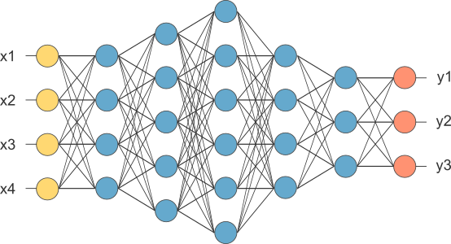
Universal Function Approximation Theorems
An Infinitely deep/wide neural network can approximate “any” function arbitrarily well
EXTREMELY parameter inefficient
Very prone to overfitting (poor generalizability)
Ignores* data structure, first principles, physics, etc.
This is why neural networks have billions of parameters.
K. Hornik, M. Stinchcombe, and H. White, “Multilayer feedforward networks are universal function approximators.” Neural Networks 2(5), pp. 359-366 (1989).
G. Gripenberg, “Approximation by neural networks with a bounded number of nodes at each level.” Journal of Approximation Theory 22(2), pp. 260-266 (2003).
Notes:
In practice, networks are chosen to be “deeper than wide,” hence “deep learning.”
Analogy: Taylor expansion of sine function – 3 parameters (amplitude, frequency, phase) with perfect accuracy to “infinity” parameters to obtain the same accuracy (or, with a finite number, diverge abruptly outside of the approximation domain).

Slide 12
Purely correlative mathematics
The mathematical structure of modern, state-of-the-art ai is purely correlative.
Cum hoc, ergo propter hoc: correlation does not imply causality.
  “Wind only blows when windmills spin. Therefore, wind is caused by windmills.”
AI mathematically cannot identify or exploit causal relationships.
AI mathematically cannot identify or exploit data structure.
In general: AI doesn’t necessarily learn meaningful correlations.
Notes:
As discussed in the Rhetoric of Aristotle.
Not that correlations aren’t important, but an AI model is just as likely to learn spurious correlations rather than correlations over meaningful features.

Slide 13
Purely correlative mathematics
Inductive reasoning: produces probable conclusions, given the premises (inference).
Deductive reasoning: produces certain conclusions, given the premises (formal logic).
Abductive reasoning: inference to the best explanation.
  Example: Occam’s Razor
  “If it looks like a duck, swims like a duck, and quacks like a duck, then it probably is a duck.”
Modern AI can only “reason” inductively.
  Moreover, this is not analogous to humans’ inductive reasoning.
  The premises are not the same!
Notes:
Overall – it’s really only superficially similar to inductive reasoning.

Slide 14
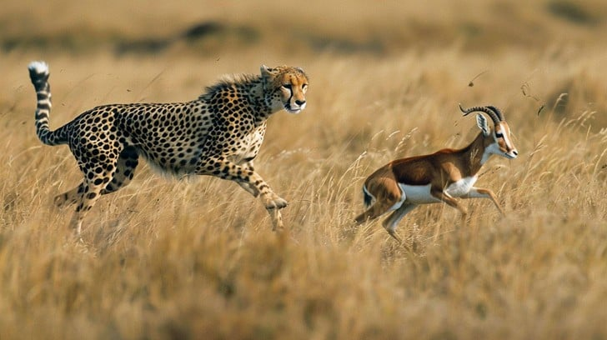
Purely correlative mathematics
In matters of life and death,
correlation over arbitrary statistical patterNs is insufficient
Notes:
You may quote me on this.
Not that correlations aren’t important, but an AI model is just as likely to learn spurious correlations rather than correlations over meaningful features.

Slide 15
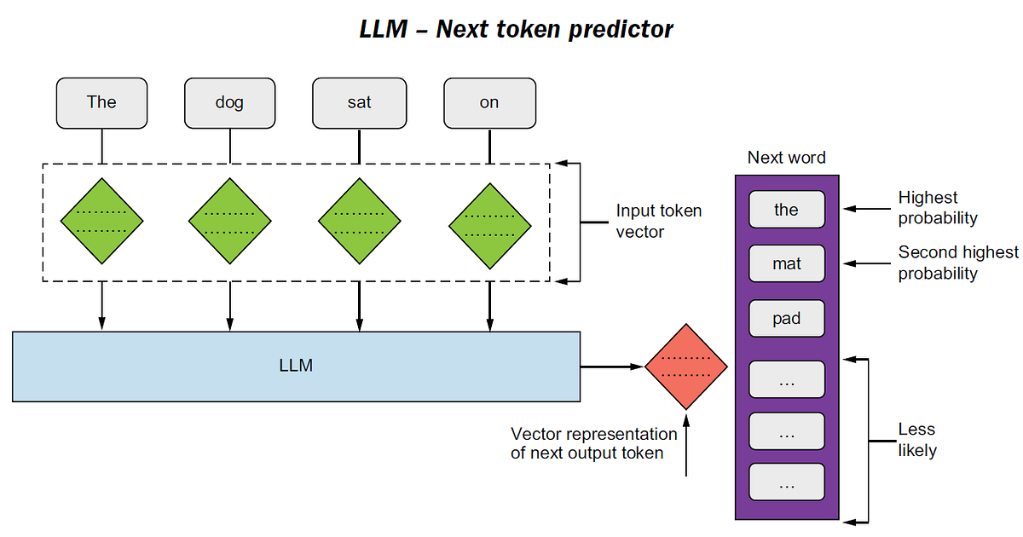
Next-token prediction
E. Gomede (2025). “The Art of Prediction: How LLMs Master Next-Token Generation” [Blog post]. Retrieved from: https://python.plainenglish.io/the-art-of-prediction-how-llms-master-next-token-generation-b8f81dc16de2/ [Accessed 03/17/2026]
Notes:
Equally valid “most probable next words:” a, my, his, her, that, etc.
Definitely cannot emulate a reasoning function.

Slide 16
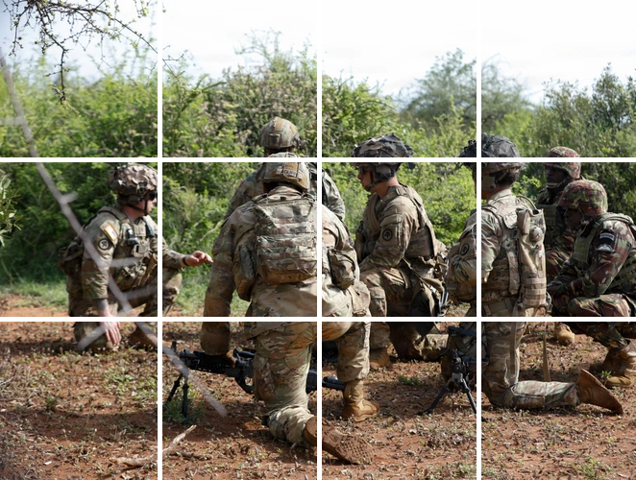
Next-token prediction
Raster the image into a sequence
Tokenize
Into the ViT
SPC John Garcia (2025). “US, Kenya infantrymen conduct M249 SAW range training during Justified Accord 2026 [Image 12 of 12].” Retrieved from: https://www.dvidshub.net/image/9560521/us-kenya-infantrymen-conduct-m249-saw-range-training-during-justified-accord-2026 [Accessed 03/17/2026].
Notes:
2D image compresses 3D scene by 1 full dimension – lossy.
2D image rastered into a 1D sequence – loses 2 full dimensions and encodes at least one of them in a terrible way – even more lossy!
Most of the underlying data structure is lost.

Slide 17
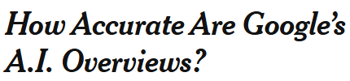
outcomes of sota AI
NYT/Oumi study found google ai overview is 90% accurate
1 in 10 answers is wrong
Produces 10s of millions of lies per hour!
T. Mickle, C. Metz, D. Freedman, T. Mondría Terol, and K. Collins. The New York Times (04/07/2026).
Notes:
Worth noting that EU courts hold Google liable for the output of its models.

Slide 18
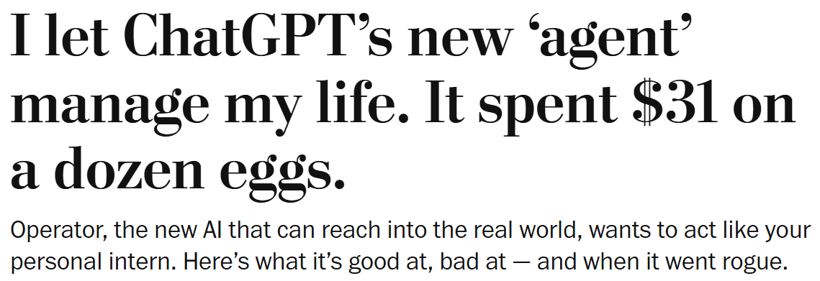
outcomes of sota agentic AI
OpenAI operator personal assistant
Within 10 minutes of being asked to “find cheap eggs in my neighborhood,” made unauthorized purchase and paid for delivery ($31 for 12 eggs).
Obviously – the eggs were not “cheap” and no purchase was authorized.
This despite built-in* safeguards requiring explicit user confirmation of purchases.
G.A. Fowler. The Washington Post (2025).
Notes:
OpenAI has replaced Anthropic (Claude) as the AI provider to the US military.
Not gonna go over, e.g., HuggingFace, as that was a failure to actually sandbox more than anything else

Slide 19
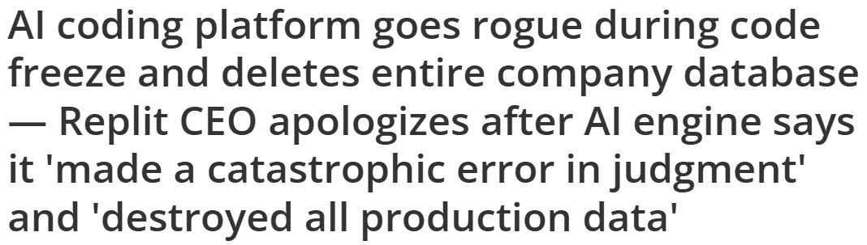
outcomes of sota agentic AI
Replit is a US technology company founded in 2016. In 2024, they released a Coding bot.
Software-as-a-Service executive had been vibe coding with Replit Agent for 9 days.
He had already given the bot a “coding and action freeze.”
H had further provided standing instructions that “NO MORE CHANGES [could be made] without explicit permission.”
It wiped an entire live database anyway: records for 1,206 executives and 1,196 companies, comprising months of work.
M. Tyson. Tom’s Hardware (2025).
Notes:
This guy is still shilling agentic AI.

Slide 20
outcomes of sota agentic AI
This one was claude opus 4.6.
Explicit instructions “never to run destructive/irreversible” commands without request and authorization.
Deleted PocketOS’s entire production database within 3 seconds, leaving the company unable to operate.
Took 2 days to recover the lost data.
A. Cuthbertson. The Independent (2026).
Notes:
And Amazon, and…

Slide 21
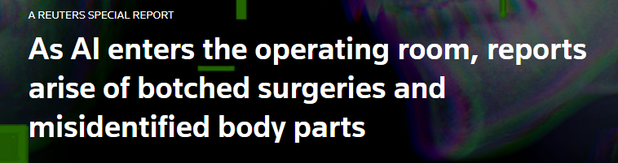
outcomes of sota agentic AI
Johnson and johnson sinus surgery assistant:
>14x reports to FDA of malfunctions and adverse events since AI was added.
>10 injuries due to AI misinforming surgeon of tool location in patient’s head.
  Cerebrospinal fluid leaking from the nose – mistakenly punctured skull – exploded carotid artery – multiple strokes…
Multiple lawsuits.
J. Dowdell, S. Stecklow, C. Terhune, and R. Levy. Reuters (2026).
Notes:
3/4 authors are Pulitzer prize winners.
This is not agentic AI – it’s a model for image segmentation – but imagine if it was.
Dozens of other devices reported – more than 2x average recall rate.

Slide 22
What we have
Arbitrary internal representations
  Difficult to align observations
  Difficult to determine what information is useful
  Difficult to compress, vulnerable to small perturbations
Purely correlative, “deterministic” mathematics
  No reasoning capabilities
  Poor uncertainty quantification
Black box models
  Post-hoc transparency
  “Deterministic” inference
  Limited (de)composability
Structure-agnostic models
  Massive, costly, slow
  Data-hungry
  Extremely lossy
Downstream
Task(s)
embodied agents
active sensing
Assume model outputs
logically follow from inputs
“AI” Models
Real World
architecture
weights
Assume model internally
aligns inputs
Sensors
Raw Data
modes
views

Slide 23
What we need
Downstream
Task(s)
Meaningful representations
  Ontologies
  Respect semantics, physics, invariants
  Extension of classical information theory
  Compressible, robust representations
Causal, uncertainty-aware reasoning
  Cross-modal predictions
  Reasoning over belief states
White or gray box models
  Transparent by design
  (De)composable by design
Structure-exploiting models
  Small, cheap, fast, adaptive to data structure
  Can learn from sparse data
embodied agents
active sensing
Real World
semantics
Meaningful
Information
state
variables
provenance
uncertainty/
belief
metadata
Sensors
modes
views
“AI” Models
Raw Data
modular
sub-models
architecture
weights
provenance
uncertainty
metadata

Slide 24
Why ontologies?
Can the full pipeline be built as an ontology?
Ontologies contain entities + relations
Data points in a distribution are related to one another by the underlying generative function
Model inputs are related to outputs by the model; likewise input and output distributions, domain translation, etc.
  Dependent on the model architecture, weights, etc. – needs to be consistent as these are updated
  Architecture dependent on intrinsic data properties?
  Composable model design?
New ontology engineering problems…

Slide 25
Why ontologies?
Ontologies have useful properties CURRENT AI/ML lacks:
Semanticity
Discreteness: representations can be broken into discrete units which combine in rule-based ways
Displacement: ability to communicate about things that are not present or do not exist
Productivity: ability to create and understand new representations
Native interoperability
Etc.

Slide 26
holy grail(s)
Unified ontological framework for:
  Measurements (model inputs)
  Models (architecture – maybe even weights/training data?) and representations
  Model predictions (outputs)
  Downstream tasks
Transparency: kill the black box
Beyond correlative models
(De)composability
  Predictive model design
Take advantage of intrinsic data properties (dimensionality, curvature, geometry/topology, etc.)
Orders of magnitude improvement across metric spectrum for AI, communications, decentralized computing

